Slide 1
Survival Analysis
CHAPTER 11

Slide 2
Learning Objectives (1 of 2)
Identify applications with time-to-event outcomes
Construct a life table using the actuarial approach
Construct a life table using the Kaplan–Meier approach

Slide 3
Learning Objectives (2 of 2)
Perform and interpret the log-rank test
Compute and interpret a hazard ratio
Interpret regression coefficients in a Cox proportional hazards regression analysis

Slide 4
Survival Analysis
Outcome is time to event.
Time to heart attack, cancer remission, death
Measure whether person has event or not.
(Yes/No) and time to event
Estimate “survival time.”
Determine factors associated with longer survival.

Slide 5
Issues with Time to Event Data
Times are positive (often skewed).
Incomplete follow-up information
Some participants enroll late.
Some participants drop out.
Study ends.
Censoring
Measure follow-up time and not time to event.
We know survival time > follow-up time.

Slide 6
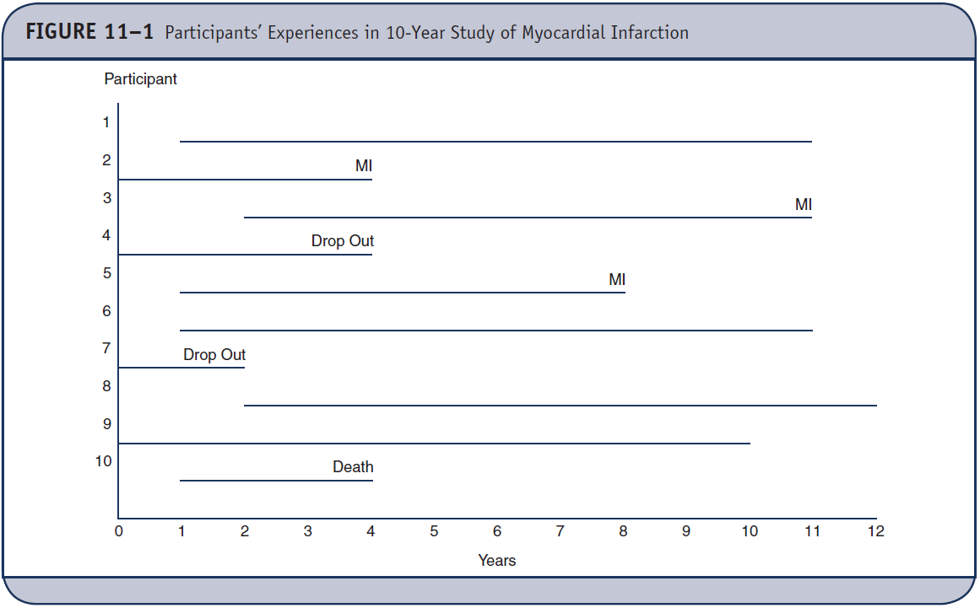
Experiences of n = 10 Participants

Slide 7
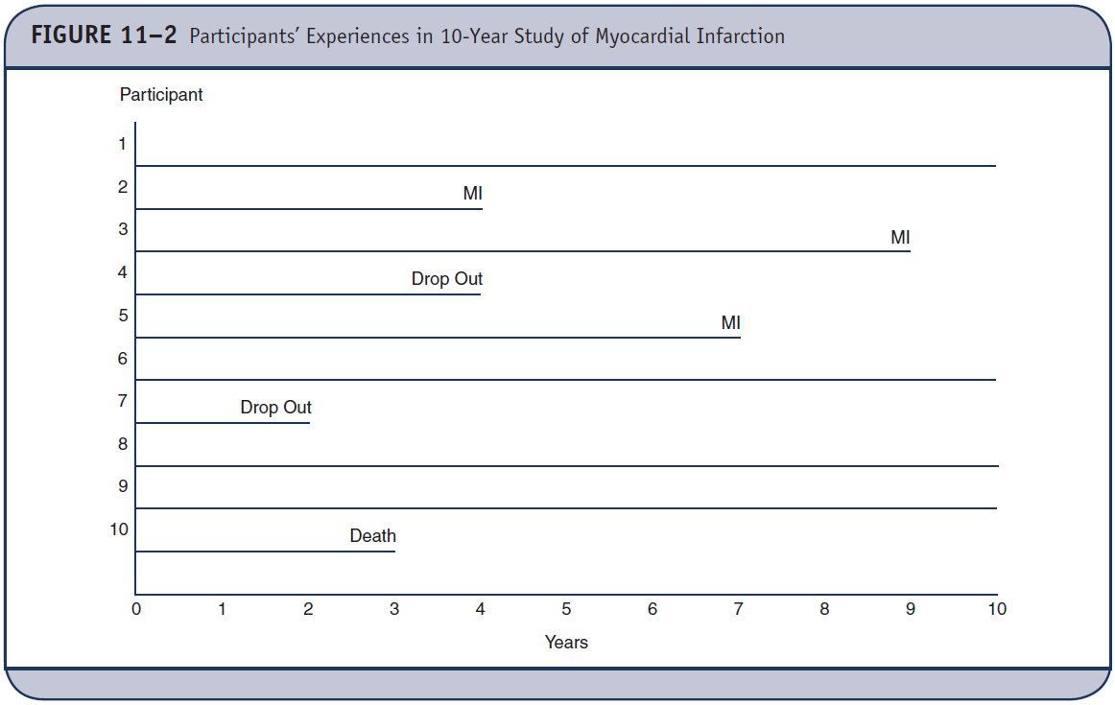
Experiences of Same n = 10 Participants, Time Projected to Zero

Slide 8
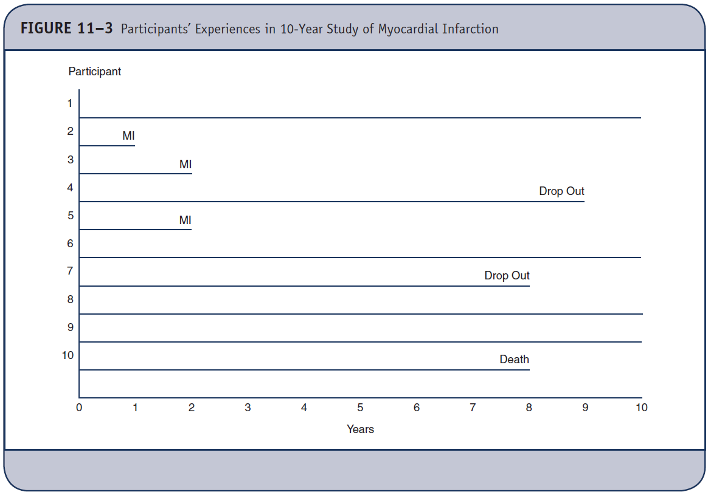
Is the Following Different?

Slide 9
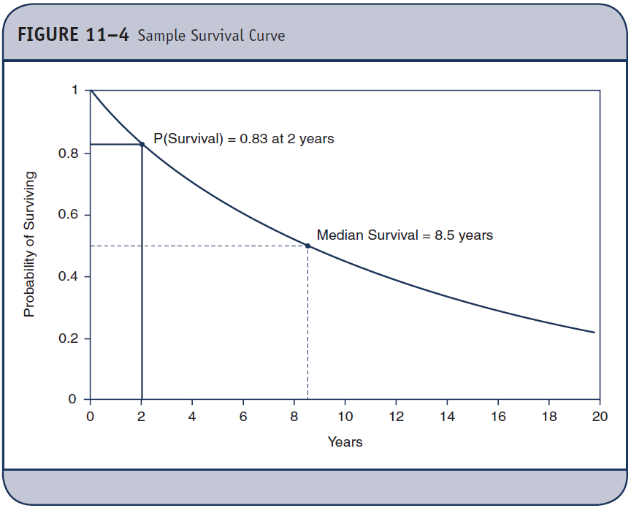
Survival Curve – Survival Function

Slide 10
Survival Curve with 95% CI

Slide 11
Estimating the Survival Function
There are many parametric approaches (which make certain assumptions about survival times).
We focus on two nonparametric approaches.
Actuarial or life-table approach
Kaplan–Meier approach

Slide 12
Example 11.2. Estimating the Survival Function (1 of 2)
Participants are 65 years and older, followed for up to 24 years until they die, the study ends, or they drop out.
n = 20 participants are enrolled over a 5-year period.

Slide 13
Example 11.2. Estimating the Survival Function (2 of 2)
Year of death or year of last contact
Years of death: 3, 14, 1, 23, 5, 17
Years of last contact: 24, 11, 19, 24, 13, 2, 18, 17, 24, 21, 12, 10, 6, 9

Slide 14
Notation
N_{t} = number of participants who are event-free and considered at risk during interval
D_{t} = number who suffer event during interval
C_{t} = number censored during interval
q_{t} = proportion suffering event during interval
p_{t} = proportion surviving interval
S_{t} = proportion surviving past interval

Slide 15
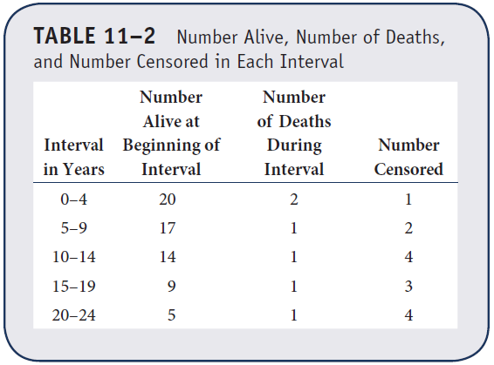
Example 11.2. Life Table

Slide 16
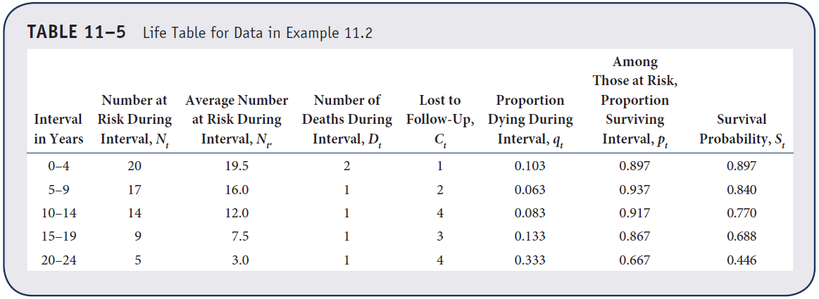
Example 11.2. Life Table—Actuarial Approach

Slide 17
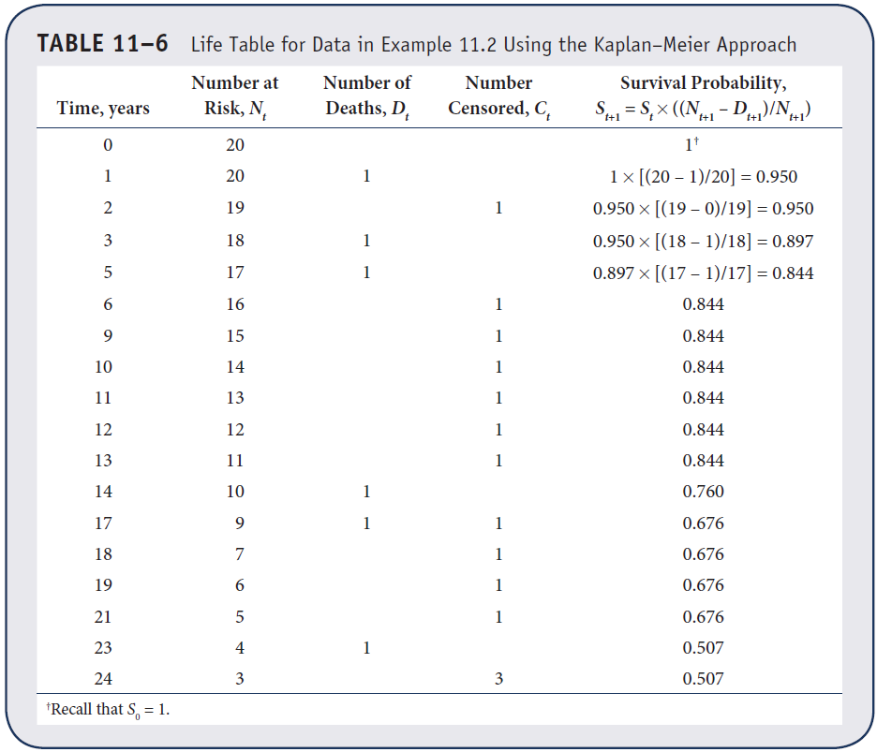
Example 11.2. Life Table—Kaplan–Meier Approach

Slide 18
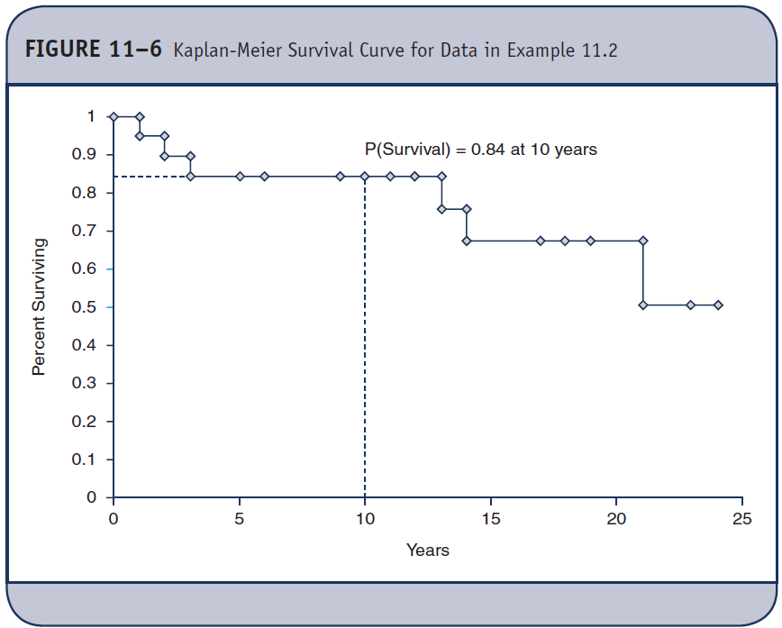
Example 11.2. Survival Function

Slide 19
Comparing Survival Curves
Log-rank test to compare survival in two or more independent groups.
Chi-square test that compares the observed numbers of events to what would be expected if the groups had equal survival

Slide 20
Example 11.3. Comparing Survival
Clinical trial to compare two treatments for advanced gastric cancer
n = 20 participants with stage IV cancer are randomly assigned to receive chemotherapy before surgery or chemotherapy after surgery.
Primary outcome is death.
Participants are followed for up to 48 months following enrollment.

Slide 21
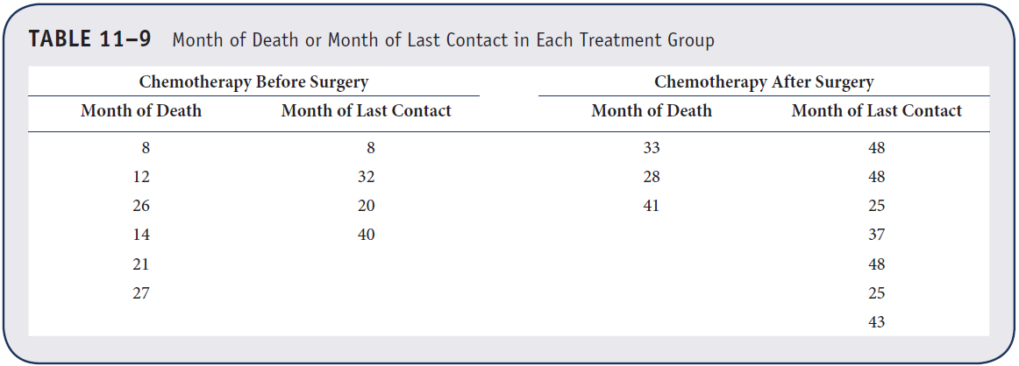
RCT to Compare Two Treatments for Advanced Gastric Cancer

Slide 22
Log-Rank Test
H₀: Two survival curves are identical
H₁: Two survival curves are not identical
Test statistic:
Reject H₀ if χ² > χ²,df where df = k – 1 and k = number of comparison groups.

Slide 23
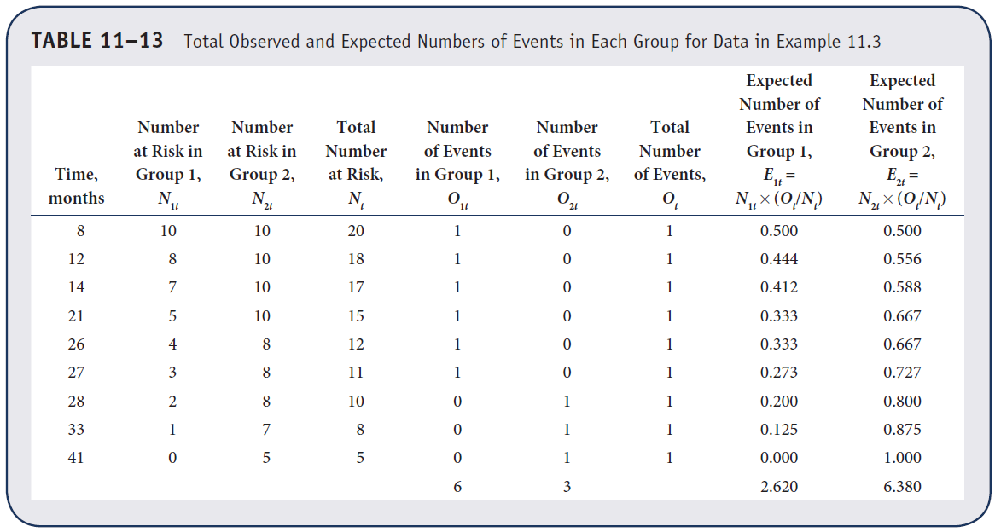
RCT to Compare Two Treatments for Advanced Gastric Cancer

Slide 24
Example 11.3. Log-Rank Test (1 of 2)
H₀: Two survival curves are identical
H₁: Two survival curves are not identical
Test statistic:

Slide 25
Example 11.3. Log-Rank Test (2 of 2)
Reject H0 if χ² ≥ 3.84.
Reject H₀ because 6.151 > 3.84. We have statistical evidence that two survival curves are not identical.

Slide 26
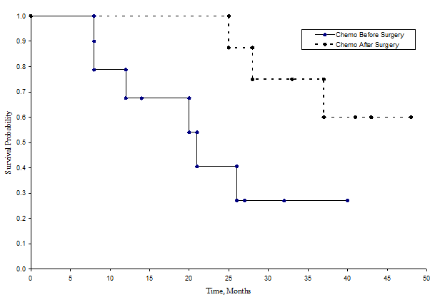
Comparing Survival Curves
H₀: Two survival curves are equal
χ2 Test with df=1. Reject H0 if χ2 > 3.84
χ2 = 6.151. Reject H0.

Slide 27
Cox Proportional Hazards Regression (1 of 2)
Model
h(t) = h₀(t) exp (b₁X₁ + b₂X₂ + … + b_{p}X_{p})
Where h(t) = hazard at time t (risk of failure at time t),
h₀(t) = baseline hazard,
X_{i} are predictors,
b_{i} are regression coefficients.

Slide 28
Cox Proportional Hazards Regression (2 of 2)
Model
ln(h(t)/h₀(t)) = b₁X₁ + b₂X₂ + … + b_{p}X_{p}
exp(b_{i}) = hazard ratios

Slide 29
Example 11.5. Cox Proportional Hazards Regression (1 of 3)
Framingham Study
Outcome = all-cause mortality
N = 5180 participants ≥ 45 years
10-year follow-up
Analysis with Cox proportional hazards regression

Slide 30
Example 11.5. Cox Proportional Hazards Regression (2 of 3)
b_{i} p HR
Age 0.11149 0.0001 1.118
Male sex 0.67958 0.0001 1.973

Slide 31
Example 11.5. Cox Proportional Hazards Regression (3 of 3)
Multivariable model
b_{i} p HR (95% CI)
Age 0.11691 0.0001 1.12 (1.11 – 1.14)
Male sex 0.40359 0.0001 1.50 (1.22 – 1.85)
SBP 0.11691 0.0001 1.02 (1.01 – 1.02)
Current
smoker 0.40359 0.0001 2.16 (1.76 – 2.64)
Total chol. 0.40359 0.0001 1.00 (0.99 – 1.00)
Diabetes 0.40359 0.0001 0.82 (0.62 – 1.08)

